Slide 1
West-Wide Governance
Pathways Initiative
Step 2 Draft Proposal Briefing

Slide 2
Agenda
Background
Review the elements of the Pathways Step 2 Draft Proposal:
  Regional Organization Scope and Function
  Regional Organization Formation
  Regional Organization Governance
  Public Interest
  Stakeholder Process
Timeline for Step 2

Slide 3
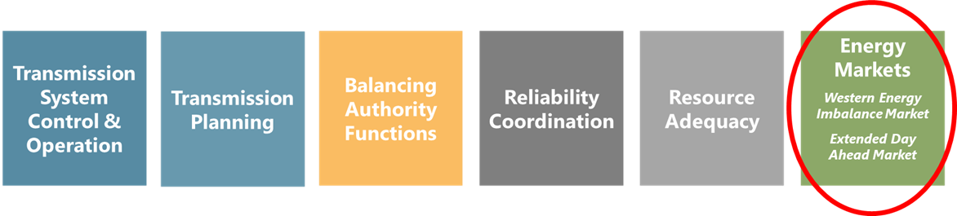
Pathways Expands Regional Coordination in Energy Markets But Leaves Other CAISO Functions Untouched

Slide 4
Summary of Recommendations
RO Launch: Option 2.0
  Policy-setting organization for the establishment and oversight of market rules for the WEIM and EDAM
Over time, consider transition to Option 2.5
  Feasibility study by the RO Board and stakeholders to assess costs, benefits, possible expanded market functions, and implementation details
  Determine future structure needs to enable continued evolution
Long-term Vision: The RO will be able to offer, on a voluntary basis, any additional services desired by Western stakeholders.
  While some utilities may not have the regulatory authority at the outset to participate in this broader menu of services, opportunities exist to gain many of the benefits of broad participation in the RO services through co-optimization of the RO’s new services under a vendor contract with the CAISO.

Slide 5
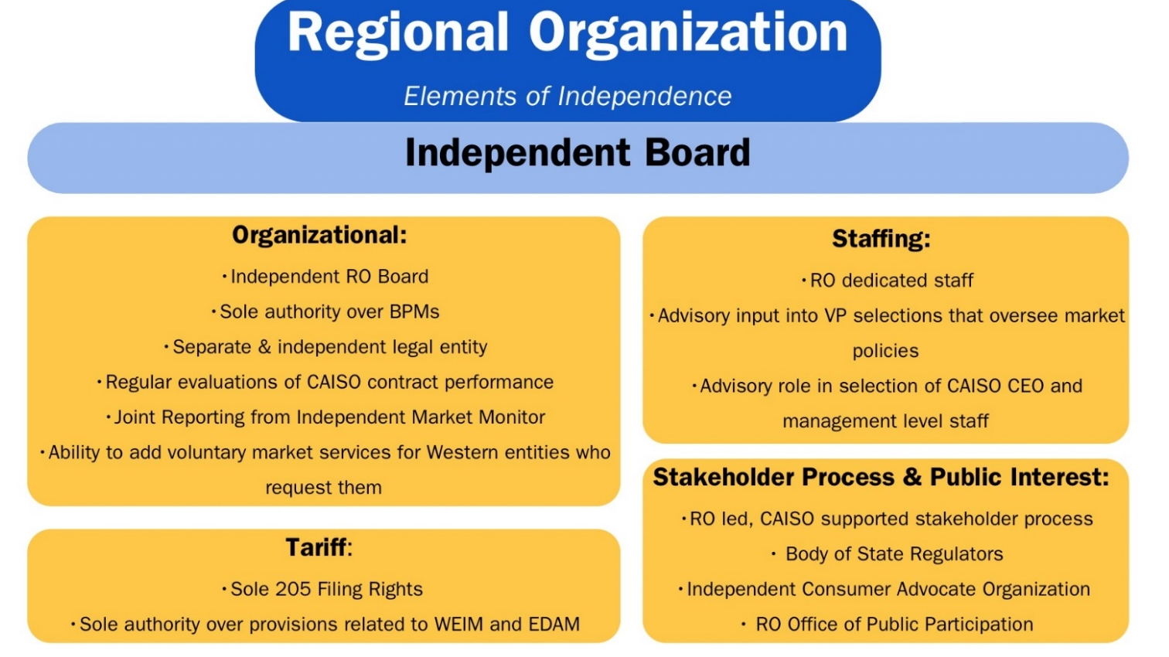
Elements of Independence

Slide 6
Pathways Initiative
Stepwise Process
Step 3
Step 2
Continue expanding the scope of regionalized functions and services offered by the Regional Organization
Step 1
Transfer governance authority over existing energy markets from CAISO to a new Regional Organization
Elevate WEIM/EDAM Governing Body authority in the governance of existing CAISO energy markets

Slide 7
Launch Committee Mission
The Mission of the Launch Committee of the WWGPI (Committee) is to develop and form a new and independent entity with an independent governance structure that is capable of overseeing an expansive suite of West-wide wholesale electricity markets and related functions based on the following core principles:
The entity should enable the largest footprint possible that includes California, and maximizes overall consumer benefits;
The entity will include independent governance for all market operations;
The new entity will preserve and build upon existing CAISO market structures that serve over 80% of the Western Interconnection, including the Western Energy Imbalance Market (WEIM) and the Extended Day Ahead Market (EDAM);
A primary goal will be to minimize duplication and incurrence of costs for both the market operator and market participants; and
The structure should be flexible to accommodate the future voluntary provisions of full regional transmission organization (RTO) services for those entities that desire to do so, but not mandate that any entity must join such a future potential RTO.

Slide 8
Evaluation Criteria
1. Maximized net benefits, including reliability, affordability and environmental benefits, recognizing startup and ongoing costs, and considering both new benefits and impacts on existing benefits.
2. Equitable representation across the Western region and among all market participants, including for a wide range of legal entities.
3. A governance structure independent of any single state, participant, or class of participants.
4. Organizational flexibility to accommodate future expansion of regional solutions and to create a credible and timely path to a voluntary RTO, including the balancing authority and transmission planning functions.
5. Optionality to allow market participants to choose the market services they value.
6. Preservation of existing balancing authorities’ ability to maintain independence, authority, and governance.
7. An implementation timeline that promotes broad market participation.
8. Respect for state authority to set procurement, environmental, reliability and other public interest policies.

Slide 9
Appendix: Step 2 Summary

Slide 10
Elements of the Step 2 Draft Proposal
Summary of Recommendations
Regional Organization Scope and Function
Regional Organization Formation
Regional Organization Governance
Public Interest
Stakeholder Process

Slide 11
Elements of the Step 2 Draft Proposal
Summary of Recommendations
Regional Organization Scope and Function
Regional Organization Formation
Regional Organization Governance
Public Interest
Stakeholder Process

Slide 12
RO Scope and Function
Under Option 2.0
  RO full governance authority over WEIM/EDAM market rules, with sole Section 205 rights
  Single integrated tariff, with process to organize CAISO tariff into sole RO, sole CAISO, or shared authority
  Market operations continue to be performed and overseen by the CAISO
  CAISO will remain the counterparty to existing market contracts
  CAISO staff will retain emergency operational authority
  Initial estimated annual cost of $1.25 to $1.5 million, increasing to $10 to $14 million as organization develops.

Slide 13
RO Scope and Function
Under Option 2.5
  RO full governance authority over WEIM/EDAM market rules with ultimate responsibility for operation of the market; sole Section 205 rights
  Possible separation of the RO tariff from CAISO tariff
  CAISO’s financial responsibility, liability, and compliance shifts to the RO
  CAISO continues market operation under a vendor contract with the RO
  RO will likely become a public utility
  RO will likely become counterparty to existing CAISO market contracts
  Estimated annual cost of $25 million- RO will have more extensive staffing

Slide 14
RO Formation
501(c)(3) nonprofit corporation
  Tax exempt status to lower costs and the ability to utilize tax-exempt financing for long term debt.
  Operates for the public benefit and is prohibited from lobbying and engaging in political activities.
Incorporated in Delaware
  Well-developed body of corporate law, knowledgeable judges, and permissive rather than prescriptive corporate formation and operation.
Principal Place of Business - TBD by RO Board
  Strong consideration to Folsom, CA to capitalize on the benefits of locating near the Market Operator.
  Board meetings would rotate among the market-participating states

Slide 15
RO Governance
Independent seven-member Board that exercises sole authority over the WEIM and the EDAM.
No reserved seats, no restriction on the number of current WEM Governing Body members serving on RO Board- interested members will move directly to Nomination Process.
RO Board Public Policy Committee
Open process for meetings/decision making
RO Board and CAISO Board have collaborative relationship; joint meetings for joint authority matters, each Board meets separately for sole authority issues
RO Formation Committee and Nominating Committee
Initiation of pre-launch implementation efforts concurrent with CA legislative session; Formation efforts after CA legislation is approved
Startup funding for the RO likely to be required before market supported funding is available- consider appropriate funding sources

Slide 16
Defining the Public Interest
Two intertwined components:
How customer interests, including affordability and reliability, are safeguarded in non-discriminatory market design and operations; and
How state and local policies, even as they differ across the West, are respected in market design.
These served as the focus and definition of “public interest” for the Launch Committee and were used to ensure that the Step 2 proposal incorporates public interest protections holistically across the new RO’s structure and processes.

Slide 17
Tools to Enhance Public Interest Protections
RO Structure and Board
RO BOSR
Consumer Advocate Organization
Office of Public Participation
Independent Market Monitor
Stakeholder Process

Slide 18
Elements of the Stakeholder Process
Stakeholder Representatives Committee (SRC)
SRC Sectors and Voting
Classification of Stakeholder Initiatives
Stakeholder Process:
  1. Issue Identification and Prioritization
  2. Stakeholder Phase:
    Stage 1 – Issue Evaluation
    Stage 2 – Policy Development
  3. Approval by the RO Board
Voting

Slide 19
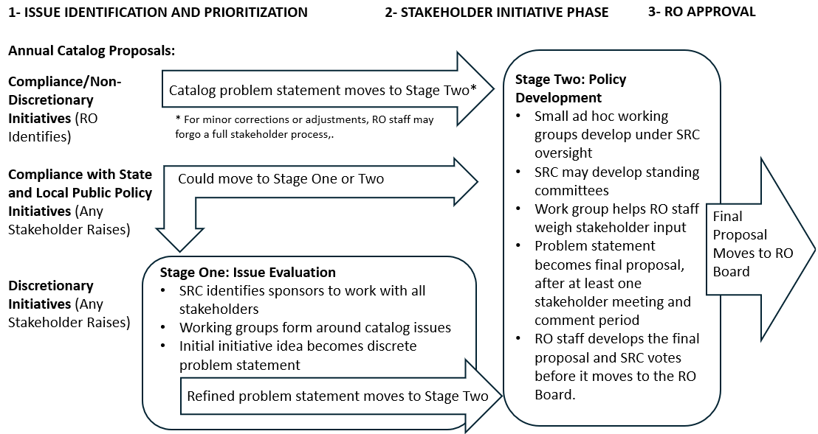

Slide 20
Timeline for Step 2
Sept 26: Issue Step 2 Draft Proposal (open comment period 4 weeks)
Oct 4: Monthly Stakeholder Meeting (review Step 2 Draft Proposal)
Oct. 7: Sector Workshop
Oct. 14: New Sector Proposal Released
Oct. 25: Step 2 and Sector Comments Due
Oct 28-Nov 14: Incorporate stakeholder feedback and make revisions to Step 2 Final Proposal
Nov 15: Issue Step 2 Final Proposal
Nov 22: Monthly Stakeholder Meeting (review Step 2 Final Proposal and vote)

Slide 21
Thank You

